Slide 1
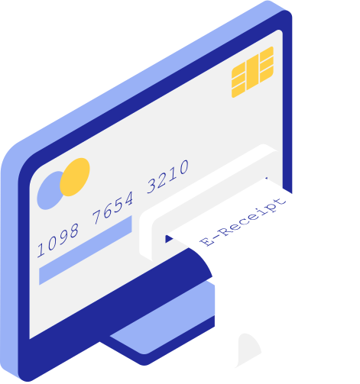

Information Security
Credit Card Fraud Detection System
Presented To: Dr. Faiza Iqbal

Slide 2

Samawia Ijaz (2020-CS-124)
Group Members
Wasfa Nasir (2020-CS-145)
Aiemen Altaf (2020-CS-148)

Slide 3
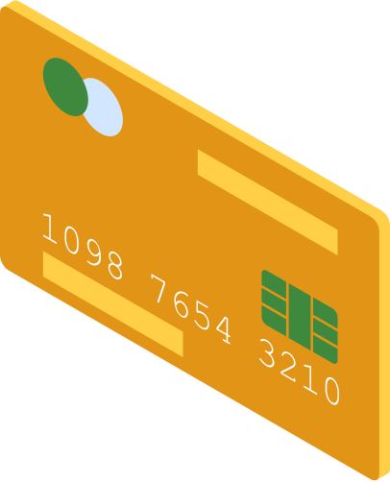
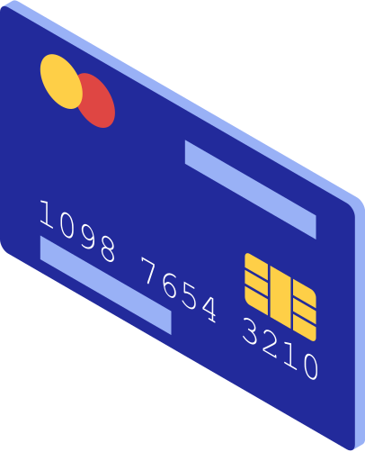
Introduction
Credit card fraud - situation when an individual uses another individual’s credit card for personal reasons while the owner is not aware of this fact

Slide 4

Credit card fraud can
occur when
•cards are lost or stolen
•mail is diverted by criminals
•employees of a business steal customer information

Slide 5
Problem Definition
Anyone who know the details of card can make a fraud transactions.
Currently, card holder comes to know only after the fraud transaction carried out.

Slide 6
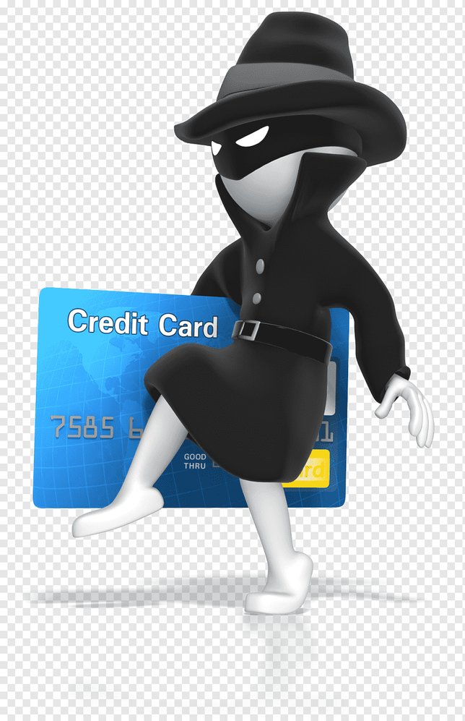
Modus operandi for credit card frauds:
lost or stolen card - 48%
identity theft - 15%
skimming - 14%
counterfeit card - 12%
phishing - 6%
other - 5%

Slide 7
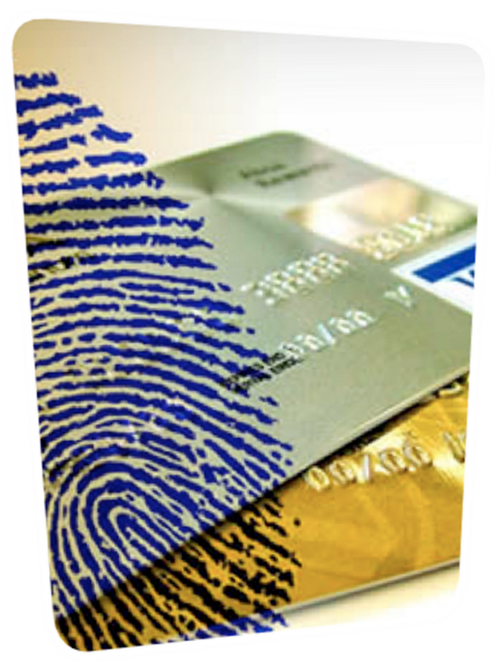
Stolen
most issuers have 24 - hour telephone numbers
unauthorized purchases until it canceled

Slide 8

Identity theft
social security or driver’s license numbers
false credentials for immigration
attributed to the victim
account takeover
true name theft

Slide 9
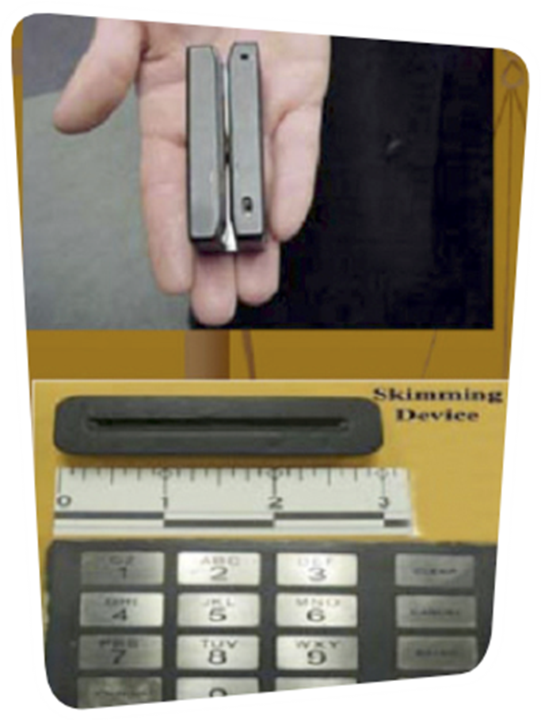
Scimming
illegal copying of information from the magnetic strip of a credit card
fake or ‘cloned’ card with your details on it

Slide 10

Phishing
massive numbers of phony e-mails to consumers
e-mails look legitimate
victims are directed to a fake web site

Slide 11
Annual Global Fraud Losses
Year Amount(in Billions)
2020 $28.6
2019 $28.7
2018 $27.9
Why does
credit card
fraud matter?
These costs “trickle down” in higher interest rates and fees for all consumers

Slide 12
Proposed Solution
A mechanism is developed to determine whether the given transaction is fraud or not.
The mechanism uses a Hidden Model to detect fraud transaction.
Develop such systems to detect fraud before it causes disaster

Slide 13
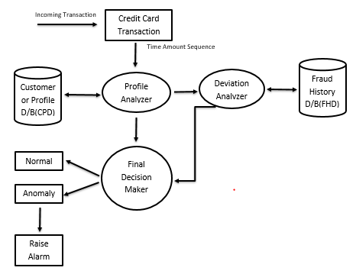
Architectural
Design

Slide 14
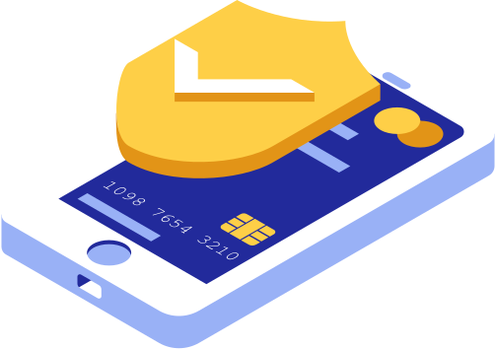
Implementation

Slide 15

Language:
Python
Tool:
Google Colab

Slide 16


Slide 17


Slide 18
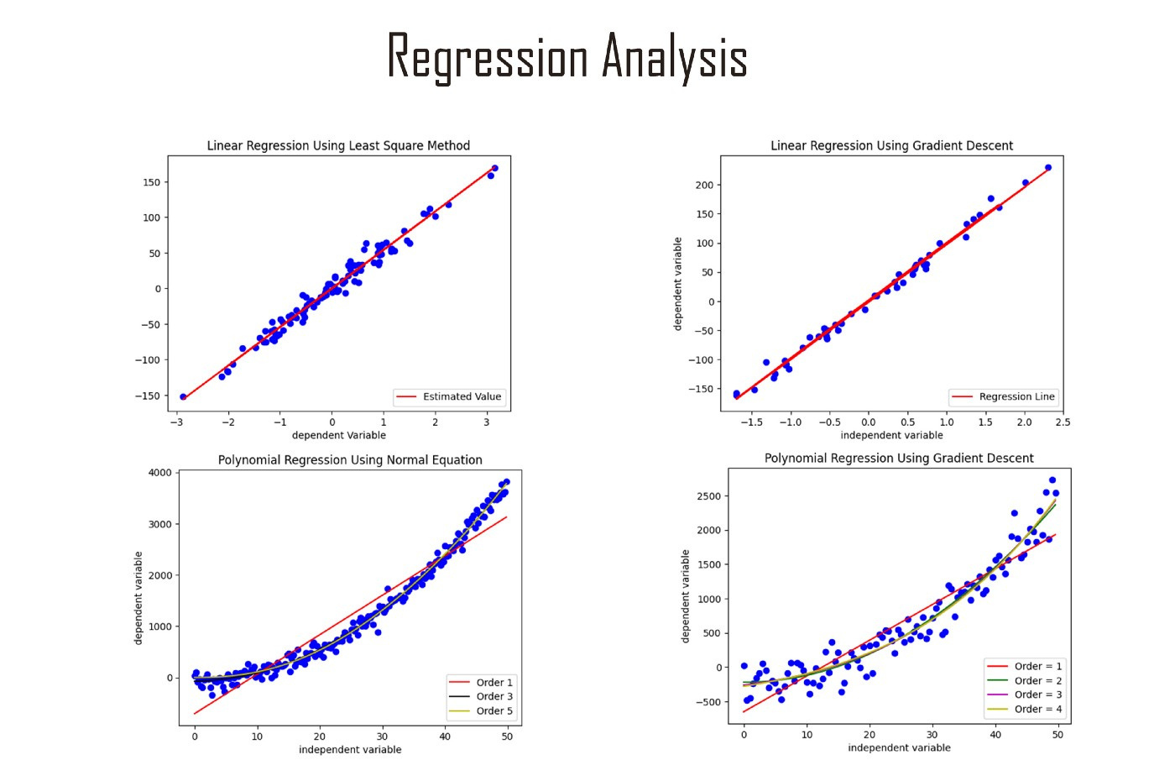

Slide 19

Implementation in Progress

Slide 20

Benefits
Reduction in number of fraud transaction
User can safely use his credit/debit card card for online transactions
No more financial loss

Slide 21

Destroy your expired cards
Immediately sign new cards
Don’t keep your PIN in your wallet
Treat credit cards as if they were real money
Lost or stolen cards should be reported immediately
Be cautious when giving information to websites or unknown individuals
Verify transactions on your statement with your receipts
Keep an eye on the credit card when making transactions in shops
Don’t sign a blank credit card receipt
Don’t borrow your cards
Guidelines to protect yourself

Slide 22
Thank You!

